Slide 1

Deep social collaborative filtering ^{[1]}
[1] W. Fan, Y. Ma, D. Yin, J. Wang, J. Tang, and Q. Li, “Deep Social Collaborative Filtering,” Jul. 2019.

Slide 2
Legacy recommender systems
Most of them only involve direct neighbors
Not all information from neighbors are useful
Notes:
Buy iPhone X but nike shoes info is not useful

Slide 3
The proposal
We propose a principle way based on deep neural networks to extract helpful information from distant social relations for recommendations
We introduce a novel way to capture user’s opinions while modeling user-item interactions
We propose a deep social collaborative filtering framework which can sufficiently exploit social network information for recommendations
We conduct comprehensive experiments on two real-word datasets to show the effectiveness of the proposed framework

Slide 4
Proposed Framework

Slide 5

Definitions and notations
User vector:$𝒰=\{u_{1},u_{2},⋯,u_{N}\}$
Item vector: $𝒱=\{v_{1},v_{2},⋯,v_{N}\}$
Rating Matrix: $R∈ℝ^{N×M}$
Where $r_{i,j}$ denotes the rating score of item $v_{j}$ given by user $u_{i}$, and 0 indicate unknown.
Social Matrix: $T∈ℝ^{N×M}$
Where $T_{i,j}=1$ if $u_{i}$ and $u_{j}$ are socially related.

Slide 6
Initialization – random walk^{[2, 3, 4, 5]}
[2] Laszlo Lovasz et al. [n. d.]. Random walks on graphs: A survey. ([n. d.]).
[3] Bosiljka Tadić. 2003. Exploring complex graphs by random walks. In AIP Conference Proceedings, Vol. 661. AIP, 24–27.
[4] Aditya Grover and Jure Leskovec. 2016. node2vec: Scalable feature learning for networks. In Proceedings of the 22nd ACM SIGKDD international conference on Knowledge discovery and data mining. ACM, 855–864.
[5] Bryan Perozzi, Rami Al-Rfou, and Steven Skiena. 2014. Deepwalk: Online learning of social representations. In Proceedings of the 20th ACM SIGKDD international conference on Knowledge discovery and data mining. ACM, 701–710.

Slide 7

Initialization – random walk^{[2, 3, 4, 5]}
Denote the user’s most relevant item with:
$S_{(i)}^{u,v}=\left\{\left(u_{\left[1\right]},v_{\left[1\right]}\right),⋯,\left(u_{\left[l\right]},v_{\left[l\right]}\right)\right\}$
$v_{[k]}={argmax}_{v_{h}∈𝒱_{u_{\left[k\right]}}}sim(v_{h},v)$
$sim\left(v_{h},v\right)=\frac{X_{h}^{T}X_{v}}{\left|X_{h}\right||X_{v}|}$
$X_{m}=f(v_{m})$

Slide 8
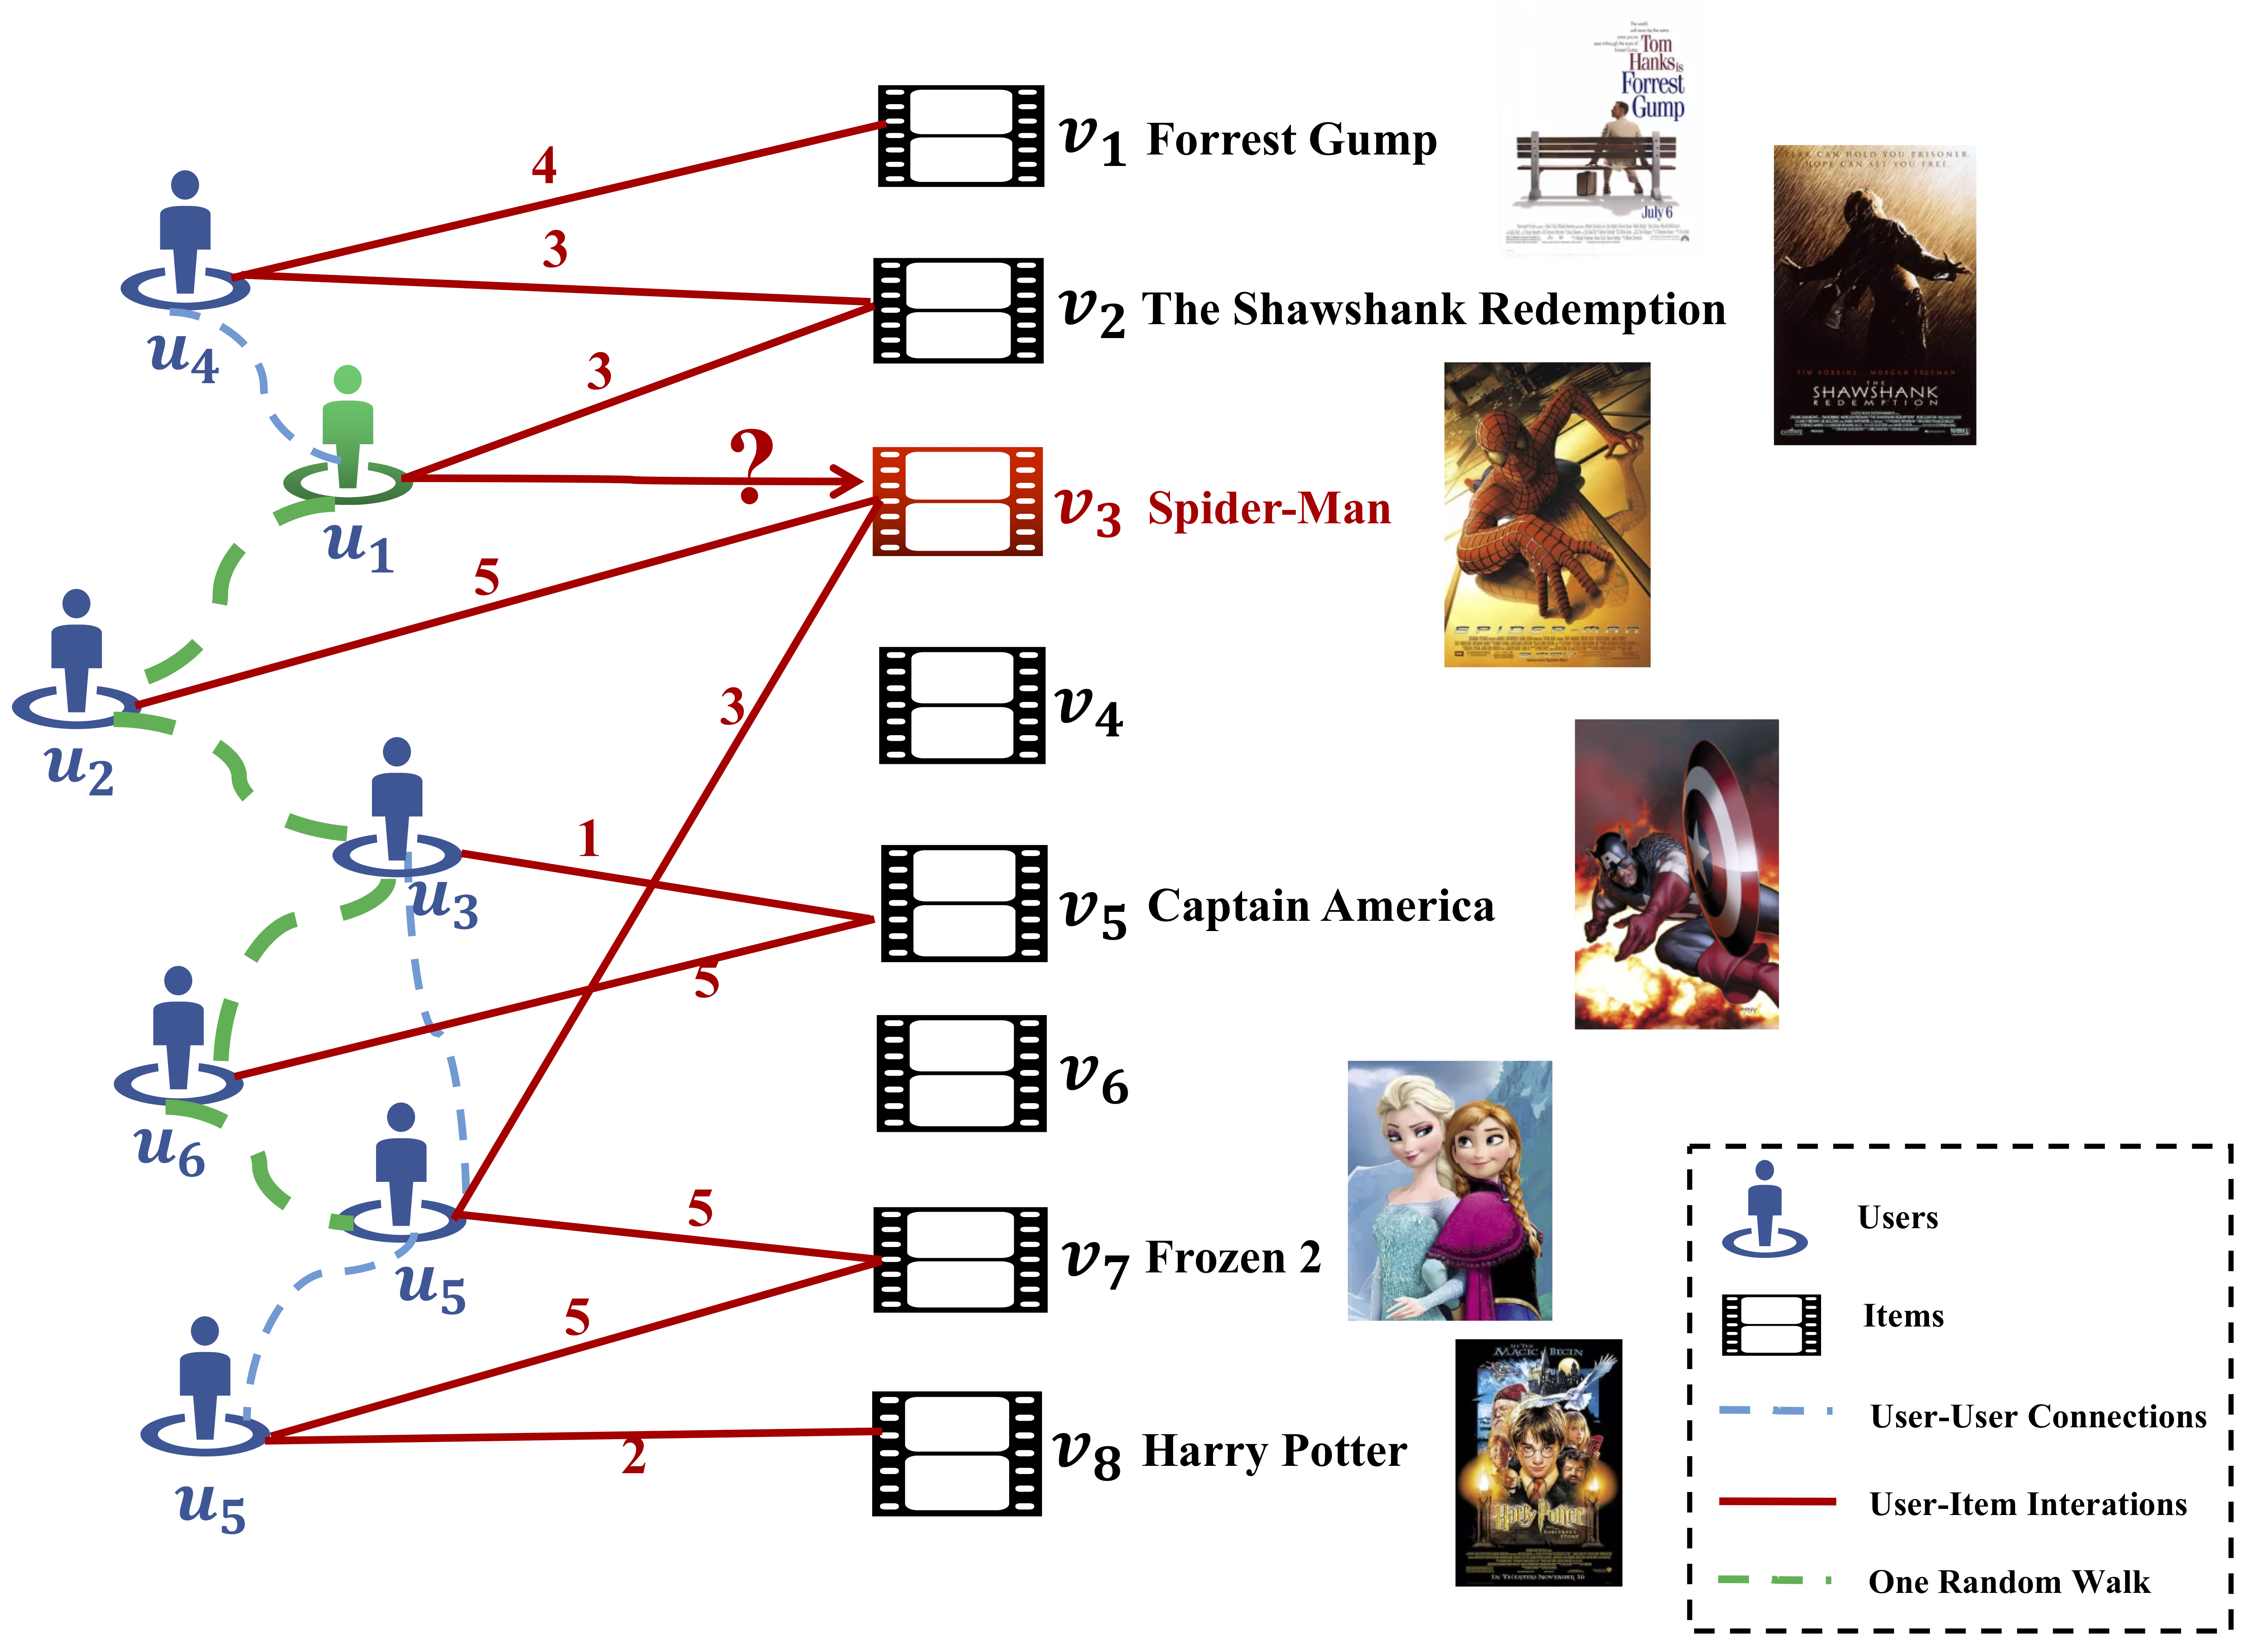

Initialization – random walk^{[2, 3, 4, 5]}
$$u_{7}$$

Slide 9

User-item interactions modeling
Considering the users’ opinions via ratings
Convert ratings to vectors (MLP)
$$e_{[k]}=g_{u,r,v}\left(\left[p_{\left[k\right]},r_{\left[k\right]},q_{\left[k\right]}\right]\right)$$
Processing each: $S_{(i)}^{u,v}=\left\{\left(u_{\left[1\right]},v_{\left[1\right]}\right),⋯,\left(u_{\left[l\right]},v_{\left[l\right]}\right)\right\}$
Get: $E_{(i)}^{u,v}=\{e_{\left[1\right],}⋯,e_{[l]}\}$

Slide 10
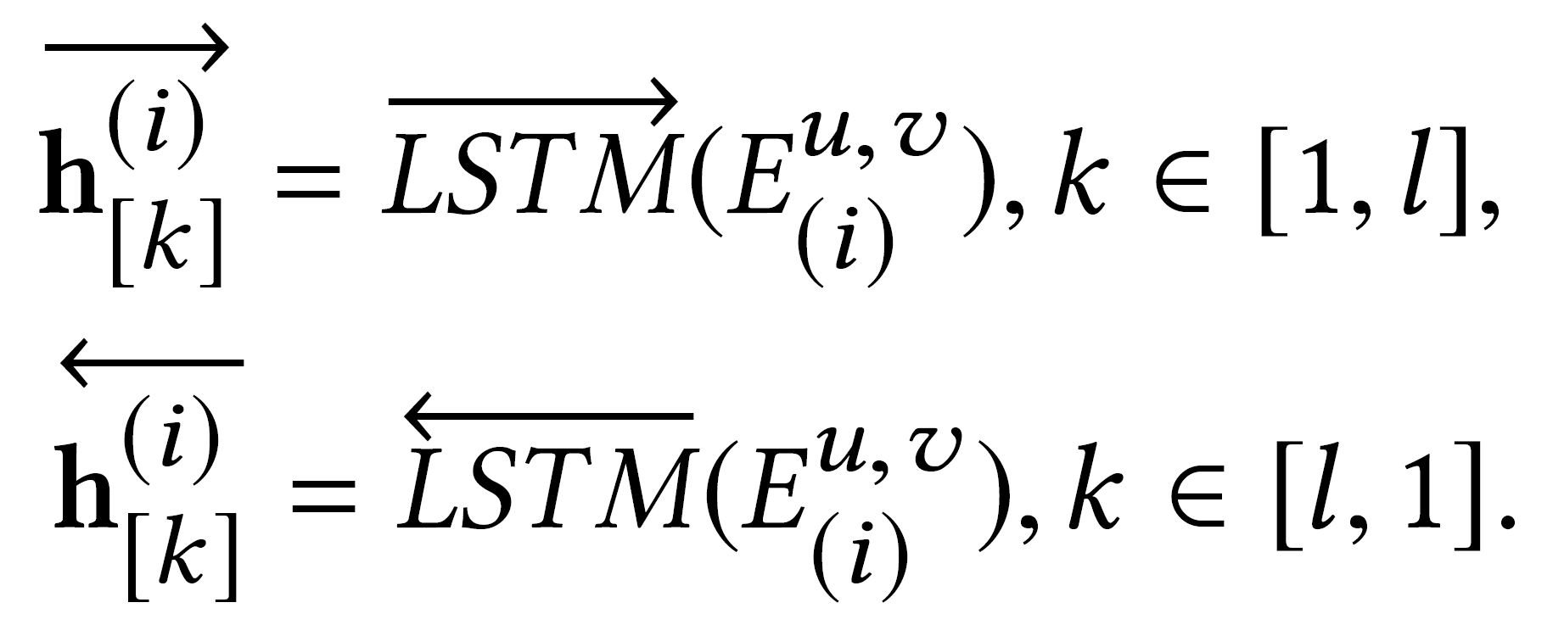
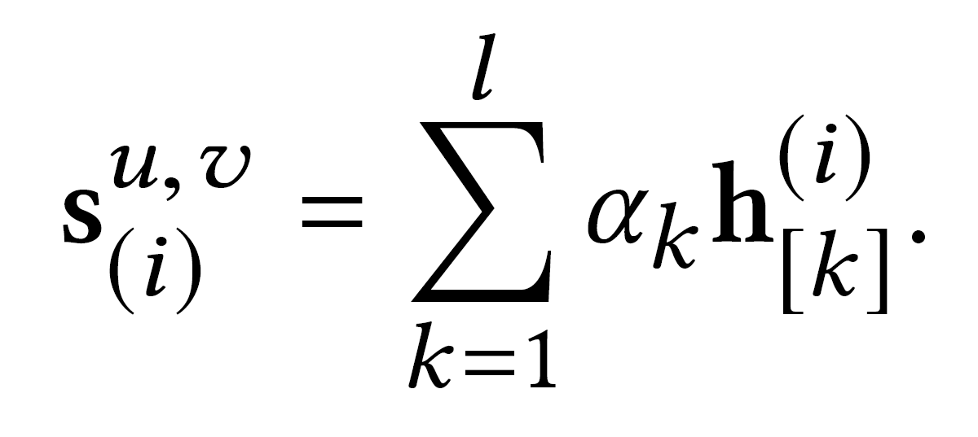
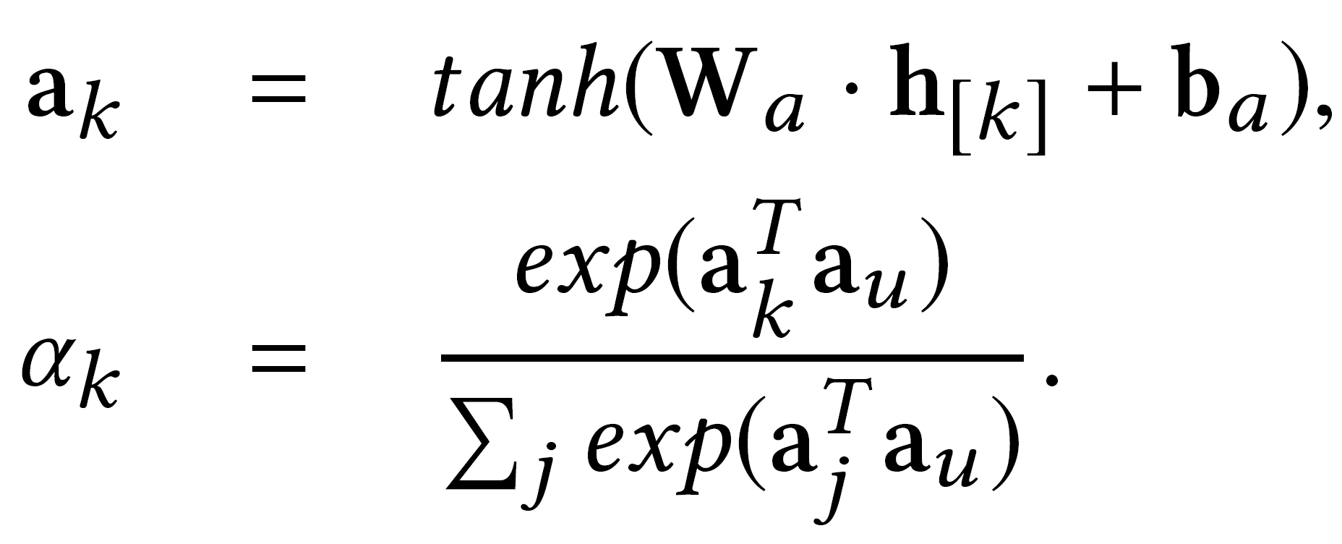
Learning representation for item-aware social sequence
Bi-LSTM based language model^{[6, 7]}
[6] Dzmitry Bahdanau, Kyunghyun Cho, and Yoshua Bengio. 2015. Neural Machine Translation by Jointly Learning to Align and Translate. In International Conference on Learning Representations (ICLR).
[7] Zichao Yang, Diyi Yang, Chris Dyer, Xiaodong He, Alex Smola, and Eduard Hovy. 2016. Hierarchical attention networks for document classification. In Proceedings of the 2016 Conference of the North American Chapter of the Association for Computational Linguistics: Human Language Technologies. 1480–1489.

Slide 11
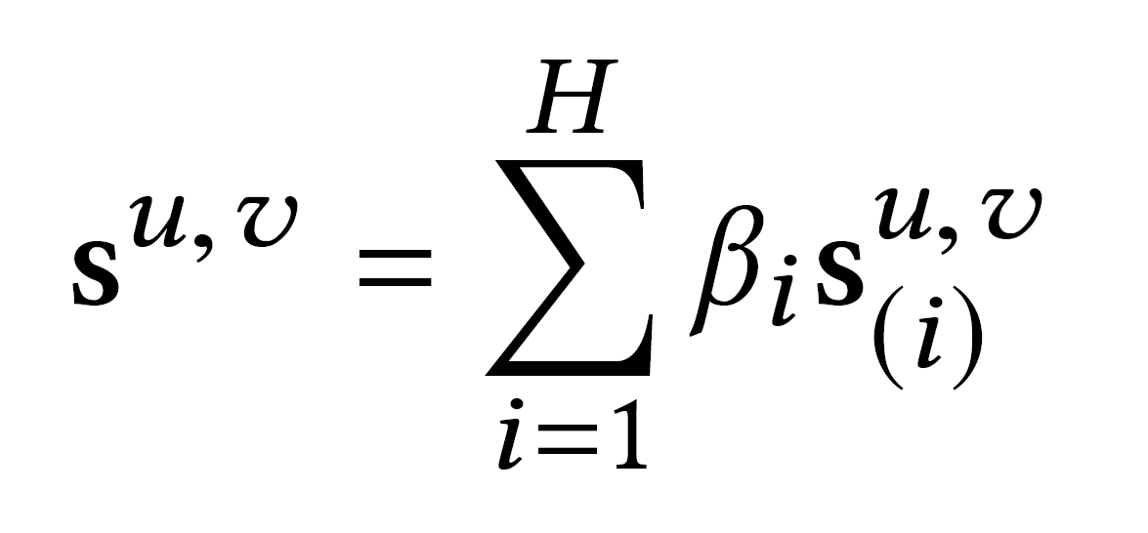
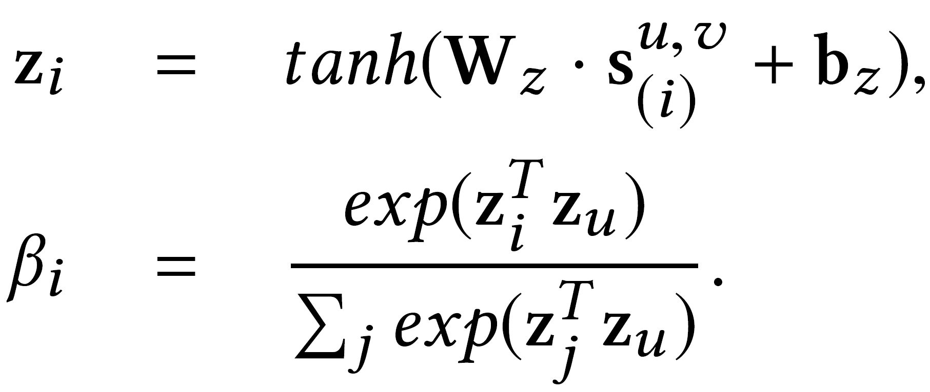
Learning representation for item-aware social sequence
Bi-LSTM based language model^{[6, 7]}
[6] Dzmitry Bahdanau, Kyunghyun Cho, and Yoshua Bengio. 2015. Neural Machine Translation by Jointly Learning to Align and Translate. In International Conference on Learning Representations (ICLR).
[7] Zichao Yang, Diyi Yang, Chris Dyer, Xiaodong He, Alex Smola, and Eduard Hovy. 2016. Hierarchical attention networks for document classification. In Proceedings of the 2016 Conference of the North American Chapter of the Association for Computational Linguistics: Human Language Technologies. 1480–1489.

Slide 12
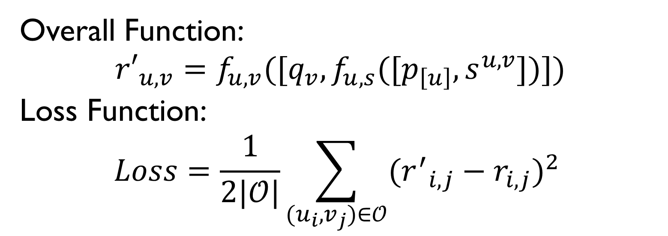
^{Rating prediction}
Overall Function:
$${r′}_{u,v}=f_{u,v}([q_{v},f_{u,s}([p_{\left[u\right]},s^{u,v}])])$$
Loss Function:
$$Loss=\frac{1}{2|𝒪|}\sum_{(u_{i},v_{j})∈𝒪}{{({r^{′}}_{i,j}−r_{i,j})}^{2} }$$

Slide 13
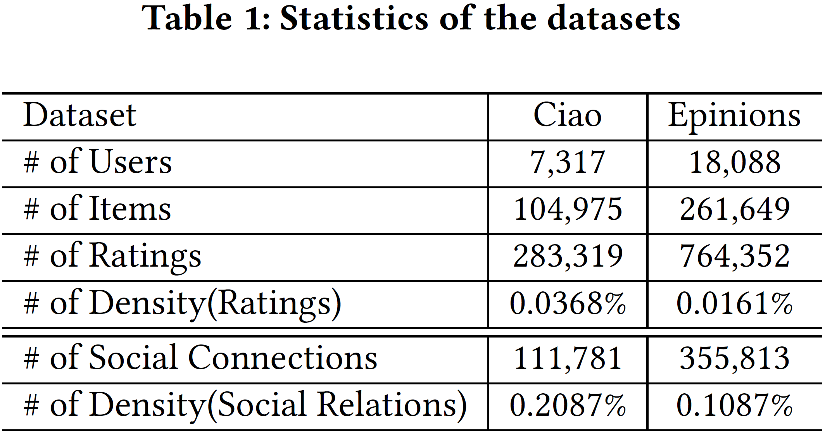
EXPERIMENTS
Ciao(www.ciao.co.uk) and Epinions (www.epinions.com)
Dataset

Slide 14
Evaluation methods^{[8]}
Mean Absolute Error (MAE)
Root Mean Square Error (RMSE)
[8] Wenqi Fan, Yao Ma, Qing Li, Yuan He, Eric Zhao, Jiliang Tang, and Dawei Yin. 2019. Graph Neural Networks for Social Recommendation. In The World Wide Web Conference. ACM, 417–426.

Slide 15
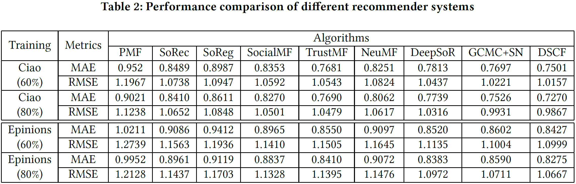
Evaluation result

Slide 16
References
[1] W. Fan, Y. Ma, D. Yin, J. Wang, J. Tang, and Q. Li, “Deep Social Collaborative Filtering,” Jul. 2019.
[2] Laszlo Lovasz et al. [n. d.]. Random walks on graphs: A survey. ([n. d.]).
[3] Bosiljka Tadić. 2003. Exploring complex graphs by random walks. In AIP Conference Proceedings, Vol. 661. AIP, 24–27.
[4] Aditya Grover and Jure Leskovec. 2016. node2vec: Scalable feature learning for networks. In Proceedings of the 22nd ACM SIGKDD international conference on Knowledge discovery and data mining. ACM, 855–864.
[5] Bryan Perozzi, Rami Al-Rfou, and Steven Skiena. 2014. Deepwalk: Online learning of social representations. In Proceedings of the 20th ACM SIGKDD international conference on Knowledge discovery and data mining. ACM, 701–710.
[6] Dzmitry Bahdanau, Kyunghyun Cho, and Yoshua Bengio. 2015. Neural Machine Translation by Jointly Learning to Align and Translate. In International Conference on Learning Representations (ICLR).
[7] Zichao Yang, Diyi Yang, Chris Dyer, Xiaodong He, Alex Smola, and Eduard Hovy. 2016. Hierarchical attention networks for document classification. In Proceedings of the 2016 Conference of the North American Chapter of the Association for Computational Linguistics: Human Language Technologies. 1480–1489.
[8] Wenqi Fan, Yao Ma, Qing Li, Yuan He, Eric Zhao, Jiliang Tang, and Dawei Yin. 2019. Graph Neural Networks for Social Recommendation. In The World Wide Web Conference. ACM, 417–426.

